Slide 1



Integration of the LEGO NXT Into Introductory Engineering Classes
Presented By
Richard W. Lucio III
Mentor
Eniko T. Enikov
Advanced Micro and Nano Systems Laboratory
Department of Aerospace and Mechanical Engineering
The University of Arizona

Slide 2
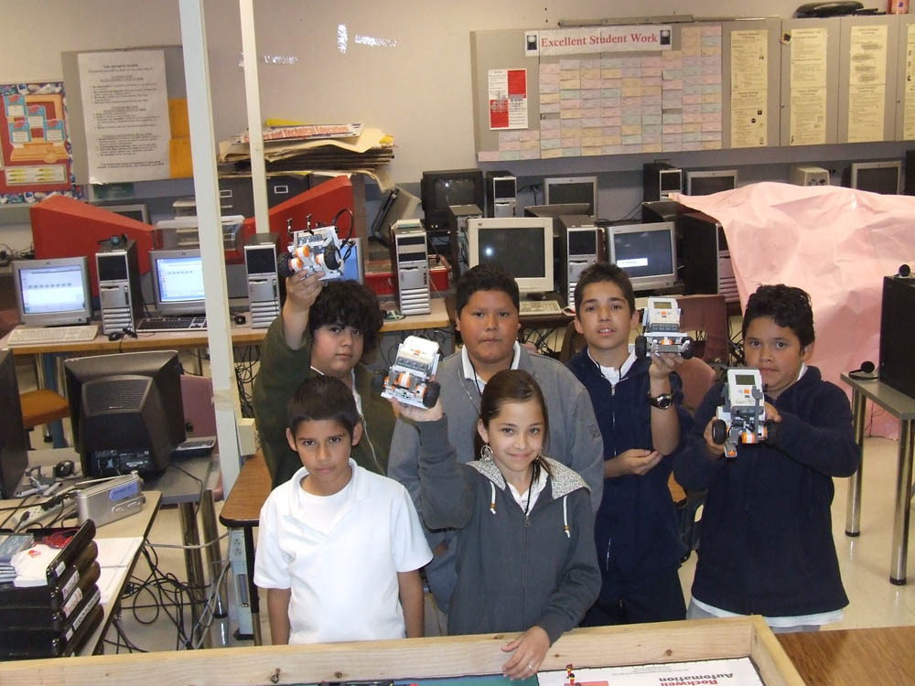
U of A Roboclub
www.roboclub.arizona.edu (est. 2008)
Started as collaboration between Tufts University (Rogers) and The University of Arizona (Enikov)
Main Objective Student Teacher Outreach Mentorship Program in K-12
As a former 101 Student we realized this could be very beneficial to beginning engineering students
http://roboclub.arizona.edu/pages/s.t.o.m.p./wakefield-middle.php

Slide 3
Current Problems With Introductory Engineering Courses
Entering student deficiencies
Expensive modeling systems
Boring or trivial projects
Trivial iterative design in projects
Projects do not allow for prototyping
Projects do not always require team work
Projects do not cover many disciplines in engineering
Catapult

Slide 4
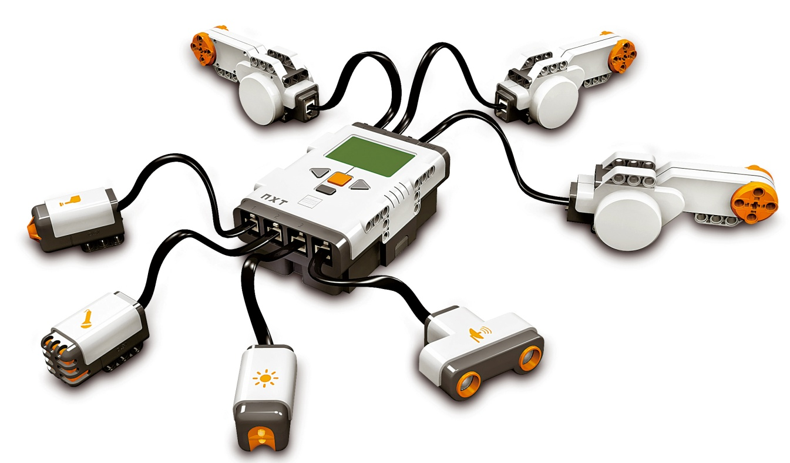
Proposed Solution
Introduce the LEGO NXT© into the classroom
servos
touch
sound
ultrasonic
light
LEGO NXT and major components

Slide 5
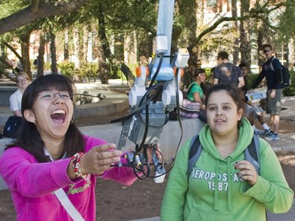
Advantages of the LEGO NXT
Relatively Cheap (about $250 w/o computer workstation)
Reusable
Intuitive
Allows for a wider variety of disciplines to be covered
Allows for cheap prototyping
Allows students to walk through an iterative design process
Unlimited Projects
Models real world work situations
http://picasaweb.google.com/uaeng.petebrown/ENG102LegoRobots#

Slide 6
The LEGO NXT ENGR 101 Project
Student Objectives
Build a robot to climb a ribbon hung two stories high off a bridge.
Stop at unknown height and report the height wirelessly
Continue to top and return to the ground
Compete against their fellow students for the fastest time
Supplies
One LEGO NXT educational kit
Basic motor characteristics (in the form of graphs)

Slide 7
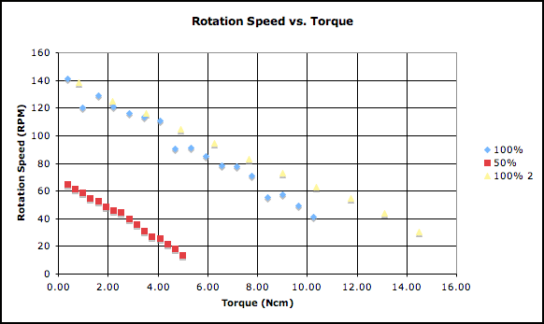
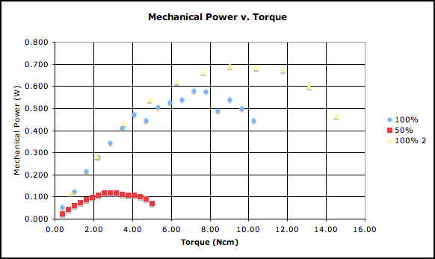
Motor Data
http://roboclub.arizona.edu/pages/gallery/nxt-motor-tests.php
Notes:
The data here helped students to determine the appropriate number of motors and weight for their robot

Slide 8
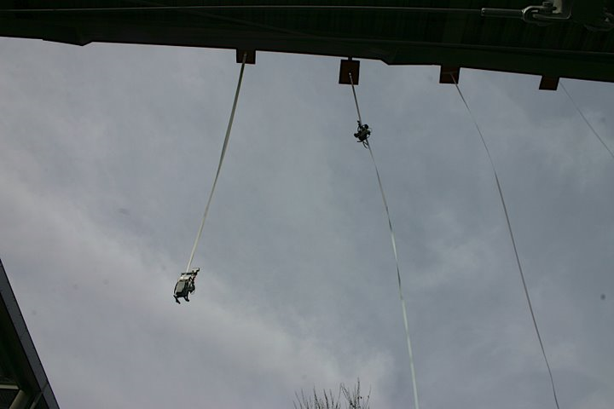
The Setup
http://picasaweb.google.com/uaeng.petebrown/ENG102LegoRobots#

Slide 9
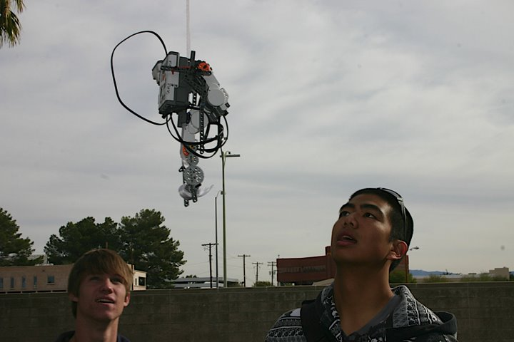
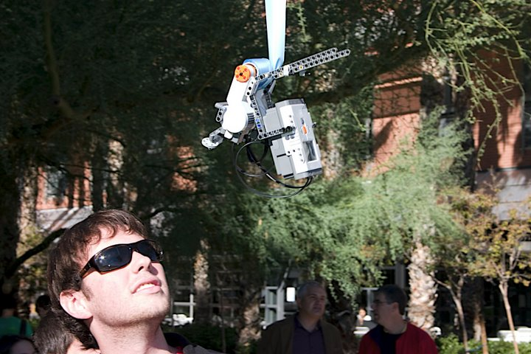
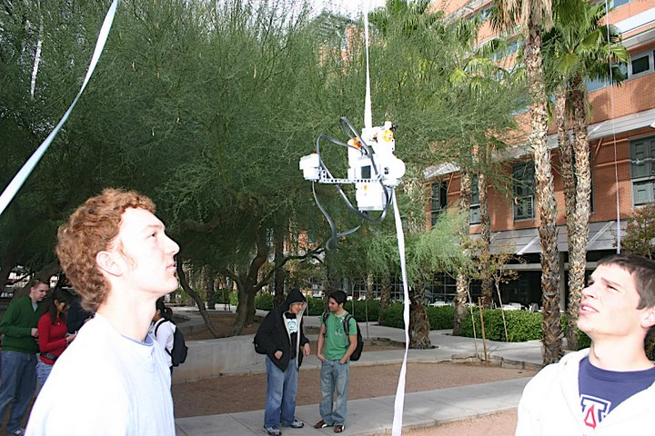
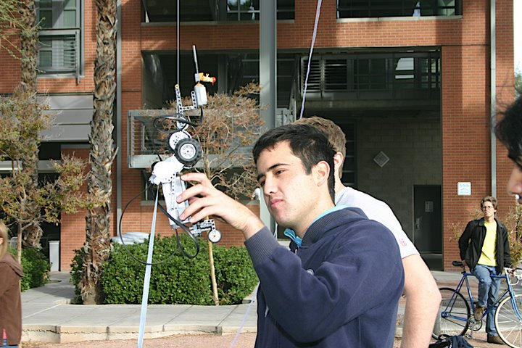
Variety of Solutions
http://picasaweb.google.com/uaeng.petebrown/ENG102LegoRobots#
Notes:
There were a variety of different robots that the students came up with demonstrating the amount of potential for creativity with in the boundaries of the project IE no forced solution.

Slide 10
What Students Needed to Consider
Final weight of their robot
How many motors to use (1-3)
Which sensors were the most appropriate for each task
Radius of the rolling / winding mechanisms
Gear ratios
Code

Slide 11
Results
Students received the project well
Real world multidiscipline teams were modeled
Students could work on a more complex project without having needing all the math, science, and programming
Important concepts were introduced
Wireless data transmission
Programming
Electrical / Mechanical Power
Importance of prototyping / iterative design

Slide 12
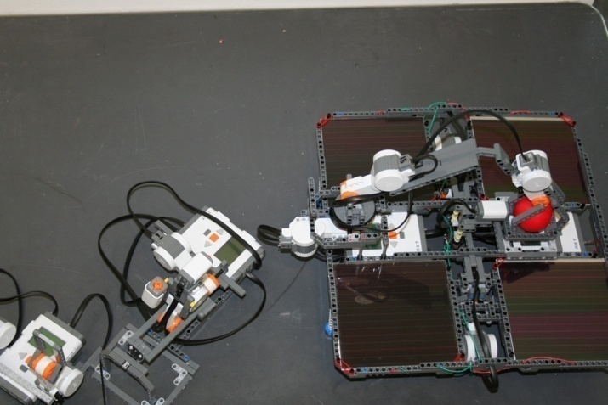
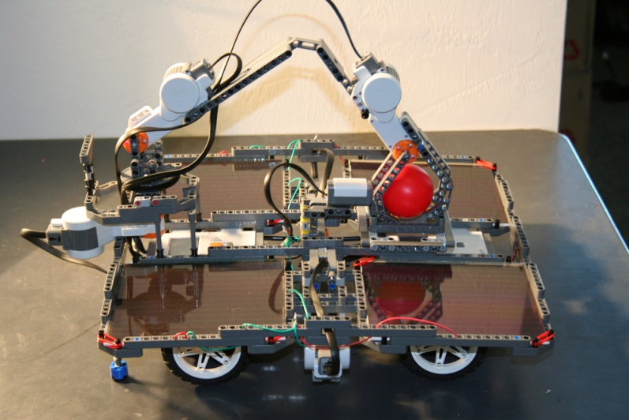
NXT Emulation of Mars Mission concepts
Wireless Communication
Remote Control
Data Acquisition
Solar Power
Storing Power
http://roboclub.arizona.edu/pages/gallery/solar-lego-project.php
Autonomous Navigation
Sensor Triggers
Environment Mapping
Data Logging
Data from sensors
http://roboclub.arizona.edu/pages/gallery/solar-lego-project.php

Slide 13
Acknowledgements
University of Arizona NASA Undergraduate Research Grant for their funding.
Dr. Jeff Goldberg and Dr Kathleen Melde for incorporating the project into their ENGR 102 classes.
STOMP program of the Center of Engineering Education and Outreach at Tufts University for their generous support.

Slide 14
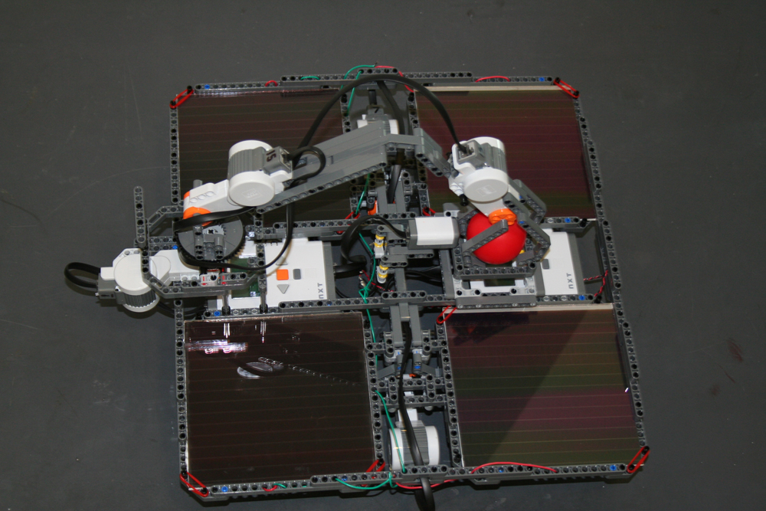
Thank You
www.roboclub.arizona.edu

